Slide 1
Piezoelectric Sensors

Slide 2
Piezoelectric Sensors

Slide 3
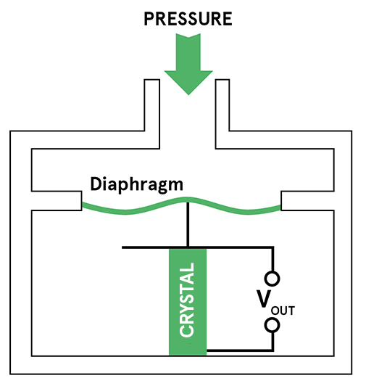
Piezoelectric Sensors

Slide 4
Piezoelectric Sensors
The word piezoelectricity means electricity resulting from pressure and latent heat.
The piezoelectric effect results from the linear electromechanical interaction between the mechanical and electrical states in crystalline materials.
A piezoelectric sensor is a device that uses the piezoelectric effect to measure changes in pressure, acceleration, temperature, strain, or force by converting them to an electrical charge.
When a force is applied to a piezoelectric material, an electric charge is generated across the faces of the crystal. This can be measured as a voltage proportional to the pressure (see diagram to the right).
There is also an inverse piezoelectric effect where applying a voltage to the material will cause it to change shape.
A given static force results in a corresponding charge across the sensor. However, this will leak away over time due to imperfect insulation, the internal sensor resistance, the attached electronics, etc

Slide 5
Piezoelectric Sensors
Piezoelectric sensors are sensitive to dynamic changes in pressure across a wide range of frequencies and pressures.
This dynamic sensitivity means they are good at measuring small changes in pressure, even in a very high-pressure environment.
Unlike piezoresistive and capacitive transducers, piezoelectric sensor elements require no external voltage or current source. They generate an output signal directly from the applied strain.
The output from the piezoelectric element is a charge proportional to pressure. Detecting this requires a charge amplifier to convert the signal to a voltage.
The high impedance output of the sensor means the circuit is sensitive to noise caused by poor connections, cable movement, electromagnetic and RF interference.
Because the piezoelectric materials are rigid, only a very small deflection of the material is required to get a usable output signal.
This makes the sensors very robust and tolerant of over-pressure conditions. It also means they respond rapidly to changes in pressure.

Slide 6
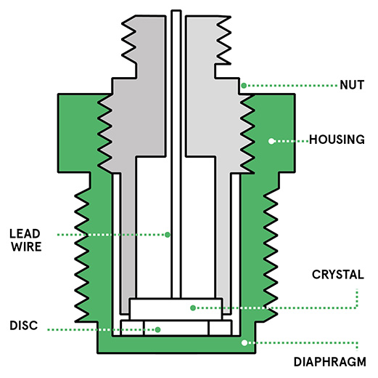
Piezoelectric Sensors

Slide 7
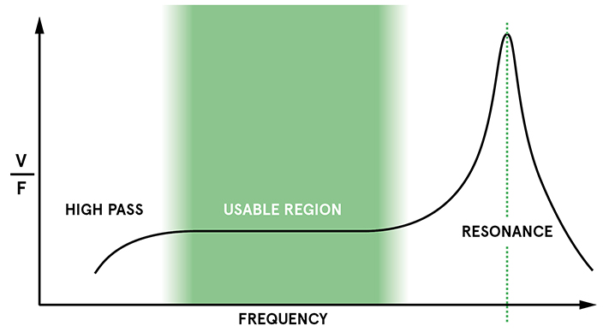
Piezoelectric Sensors

Slide 8
Advantages of Piezoelectric Sensors
They are rugged. This makes them suitable for use in a variety of harsh environments.
piezoelectric sensors can be used at high temperatures. Some materials will work at up to 1,000ºC.
The output signal is generated by the piezoelectric element itself, so they are inherently low-power devices.
The sensing element itself is insensitive to electromagnetic interference and radiation.
Piezoelectric sensors can be easily made using inexpensive materials (for example quartz or tourmaline).

Slide 9
Applications of Piezoelectric Sensors
The robustness, high frequency and rapid response time of piezoelectric pressure sensors means they can be used in a wide range of industrial and aerospace applications where they’ll be exposed to high temperatures and pressures.
They are often used for measuring dynamic pressure, for example in turbulence, blast, and engine combustion. These all require fast response, ruggedness and a wide range of operation.
Their sensitivity and low power consumption also makes them useful for some medical applications. For example, a thin-film plastic sensor can be attached to the skin and used for real-time monitoring of the arterial pulse.

